Slide 1
A Novel Approach for Auto-Tuning Hadoop’s Configuration
Team Members:
B.MANASWINI (506)
G.SUKANYA (519) P. CHAITANYA (512)
S.NANDINI (561)
K. MURALI KRISHNA (535)
Project Guide:
K.VARA PRASAD

Slide 2
CONTENTS
Introduction
Abstract
Existing System
Existing System Architecture
Proposed System
Proposed System Architecture
System Requirements Specification
Literature Survey
System Analysis
Algorithm
Uml Diagrams
System overview
Implementation
Test cases
Conclusion
Future Enhancement
Bibliography

Slide 3
INTRODUCTION
Hadoop is an open-source software.
Apache Hadoop is used for processing and generating vast data sets on large scale compute cluster by using the MapReduce programming model.
MapReduce framework used for distributed storage and processing of dataset of big data.
The core of Apache Hadoop consists of a storage part, known as Hadoop Distributed File System (HDFS), and a processing part which is a MapReduce programming model.
Hadoop splits files into large blocks and distributes them across nodes in a cluster.
It then transfers packaged code into nodes to process the data in parallel.

Slide 4
ABSTRACT
Hadoop represents a java based distributed computing framework i.e., designed to support applications.
Hadoop performance however is significantly affected by the settings of the Hadoop configuration parameters. Unfortunately, manually tuning these parameters is very time-consuming.
Random forest approach, which automatically tune the Hadoop configuration parameters for optimized performance for a given application running on a given cluster.
MapReduce programming model for large-scale data processing for speed up performance.
In the Novel Technique uses Dynamic Approach for performing speed up of the available resources.

Slide 5
The dynamic technique has the three slot allocation technique.
DHSA
SEPB
Slot Prescheduling.
It contains the two major operations:
Slot utilization optimization.
Utilization efficiency optimization.
It achieves a performance speed up by a factor of over the recently proposed Cost Based Opitimization (CBO) approach.

Slide 6
Existing System
Hadoop framework has up to 190 configuration parameters,and it is highly sensitive to the settings of the parameters.
RFHOC,is a typical characteristic of these applications is that they run repeatedly with different input data sets.
In Random Forest Approach,the Hadoop configuration parameters for optimized performance for a given application running on a given cluster.
The model takes Hadoop configurations as input and outputs a performance prediction.
In a subsequent step, the performance prediction models for each phase as part of a genetic algorithm to search for the optimum Hadoop configuration.
RFHOC,is extremely tedious and time consuming.

Slide 7
Existing System Architecture
RFHOC Profiling
RFHOC Modeling
RFHOC Searching
Industrial
Environment
Small
Input
Data
Random
Generated
Configurations
Iterative Search
Application
Job
Randomly Sample
Regression
Models For Map and
Reduce Stage
Periodically
Periodically
Random
Forest
Algorithm
updating
running
Hadoop Cluster
Generic
Algorithm
Workload Profiler
Big Input
Data
Routine
Job
Input data size
Output data size
Execution time
Hadoop Configuration
Hadoop
Configuration
For Optimized
Performance
Hadoop Cluster

Slide 8
Proposed System
The Novel technique is used to improve performance speedup using three techniques.
Dynamic slot allocation Scheme (DSAS), it allows slot to reallocate or reduce slots based on its need.
Execution Performance balancing Scheme to balance the performance criteria between single job and group of jobs.
Slot Pre-scheduling technique that can perform data locality with cost fairness to produce a system called Dynamic MR.
In addition to the multi data center processing to add clustering concept,it splits the data and process the data in multiple datacenters.
By combining the similar data into clusters we can process the data in short execution time. After preprocessing,they split into multiple files and apply clustering process.

Slide 9
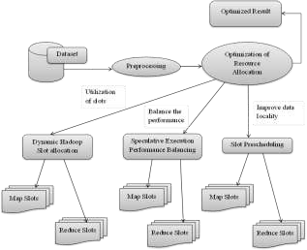
PROPOSED SYSTEM ARCHITECTURE

Slide 10
SYSTEM REQUIREMENTS
HARDWARE REQUIREMENTS:
System : i3 Processor
Hard Disk : 500 GB.
Monitor : 15’’ LED
Input Devices : Keyboard, Mouse
Ram : 4GB.
SOFTWARE REQUIREMENTS
Operating system : Windows 7/UBUNTU.
Coding Language : Java 1.7 ,Hadoop 0.8.1 (for Maper and Reducer)
Back End : Hadoop Cluster
Tool : Virtual Box Oracle tool
Evaluation : PHP, Javascript (Intelligent Graph)

Slide 11

Literature Survey
Limitation: This system automatically tune the Hadoop configuration parameters and build analytical models based on accuracy and performance improvements.
Dili Wu and AniruddhaGokhaleA ,”SelfTuning System based on Application Profiling and Performance Analysis for Optimizing HadoopMapReduce Cluster Configuration” .
Limitation: Despite its popularity, however, the Hadoop framework manage the resources of a MapReduce cluster, and configuring the framework which optimize the performance and reliability of MapReduce applications.
Chi-Ou Chen, Ye-Qi Zhuo, Chao-Chun Yeh, Che-Min Lin, Shih-wei Liao, “Machine Learning-Based Configuration Parameter Tuning on Hadoop System”

Slide 12
Literature Survey(cont)
Limitation: The prediction phase is to estimate the performance of a MapReduce job.
Xiaoan Ding, Yi Liu, DepeiQian, “JellyFish: Online Performance Tuning with Adaptive Configuration and Elastic Container in Hadoop Yarn”.
Limitation:
Experimental results show that JellyFish can improve performance of MapReduce jobs by an average of 24% for jobs run for the first time, and by an average of 65% for jobs run multiple times compared to default YARN.
Amelie Chi Zhou and Bingsheng,“HeTransformation-Based Monetary Cost Optimizations for Workflows in the Cloud”

Slide 13

Feasibility Study
System Analysis
There are three key consideration involved in feasibility analysis are:-
Economical Feasibility
Technical Feasibility
Social Feasibility
Economic Feasibility
The amount of fund that the company can pour in to the reasearch and development of the system is limited.
The developed system produce with in the budget and most of the technologies used are freely available.

Slide 14
Technical Feasibility
The system must not have a high demand on the available technical resourses.
The developed system must have a modest requirement, as only minimal or null changes are required.
Social Feasibility
To check the level of acceptance of the system by the user.
The process of training the user to use the system efficiently.
The user must not feel threatened by the system, instead must accept it as a necessity.

Slide 15
Algorithms
GENETIC ALGORITHM:
The GA takes the performance predictions obtained by our random forest based models and the corresponding configurations as input to globally search the configuration optimization space.

Slide 16
Genetic Algorithm
Initial Configuration Values
Performance Models
1
read
phase
model
map
phase
model
collect
phase
model
spmg
phase
model
{c₁₁,….c_{1n}}
{c_{m1},….c_{mn}}
2
+
Sum of executions time of the four phases
Cross-Over (Random)
Fitness value
New
Configuration Values
{c₁₁,….c_{1n}}
{c_{m1},….c_{mn}}
Mutate
(rate 0.01)
3
{c₁₁’,….c_{1n}’}
{c_{m1}’,….c_{mn}’}
Genetic Algorithm

Slide 17
Algorithms
RANDOM FOREST:
Random forest is an ensemble model for both classification and regression.
It operates by constructing a multitude of decision trees at training time prediction then combines the outputs by the individual trees to arrive at the final output .
A key feature of random forests is that they are correct for decision trees tendency to overfit to their training data.

Slide 18
Random Forest Algorithm
INPUT:-
Training set S, Inducer F, integer ntree(# of bootstrap samples)
Draw ntree bootstrap samples from the training set
For i=1 to ntree
{
Store the bootstrap in S’
3. S’=bootstrap sample from S(i.i.d. sample with replacement).
Procedure is represented by inducer F and the result is stored in C_{i}
4. C_{i} =F(S’)
5. }
6. C*(x)=arg ∑C_{i}(x)/ntree
OUTPUT:-
Aggregation C*

Slide 19
Data Flow Diagram
DFD is also known as bubble chart. A DFD may be used to represent a system at any level of abstraction.
DFD may be partitioned into levels that represent increasing information flow and functional detail.

Slide 20
Dataflow diagram

Slide 21
UML Diagrams
The Unified Modeling Language is a standard language for specifying, Visualization, Constructing and documenting the artifacts of software system, as well as for business modeling and other non-software systems.
There are two categories of UML diagrams:
Structural Diagrams : structural diagrams represents the static aspect of the system.(which forms main structure)
Behavioral Diagrams : Behavioral diagrams represents the dynamic aspect of the system.(further described as the changing or moving party of a system)

Slide 22
Class Diagram
Class diagram in the Unified Modeling Language (UML) is a type of static structure diagram that describes the structure of a system by showing the system's classes, their attributes, operations (or methods), and the relationships among the classes.
It explains which class contains information.

Slide 23
Class diagram

Slide 24
Use Case Diagram
A use case diagram is a type of behavioral diagram defined by and created from a Use-case analysis.
Its purpose is to present a graphical overview of the functionality provided by a system in terms of actors, their goals (represented as use cases), and any dependencies between those use cases.
The main purpose of a use case diagram is to show what system functions are performed for which actor.

Slide 25
Use Case diagram

Slide 26
Activity Diagram
In the Unified Modeling Language, activity diagrams can be used to describe the business and operational step-by-step workflows of components in a system.
An activity diagram shows the overall flow of control.

Slide 27
Activity diagram

Slide 28
Sequence Diagram
A sequence diagram in Unified Modeling Language (UML) is a kind of interaction diagram that shows how processes operate with one another and in what order.

Slide 29
Sequence Diagram

Slide 30
Software overview
Java :
Mainly we used java for programming.

Slide 31
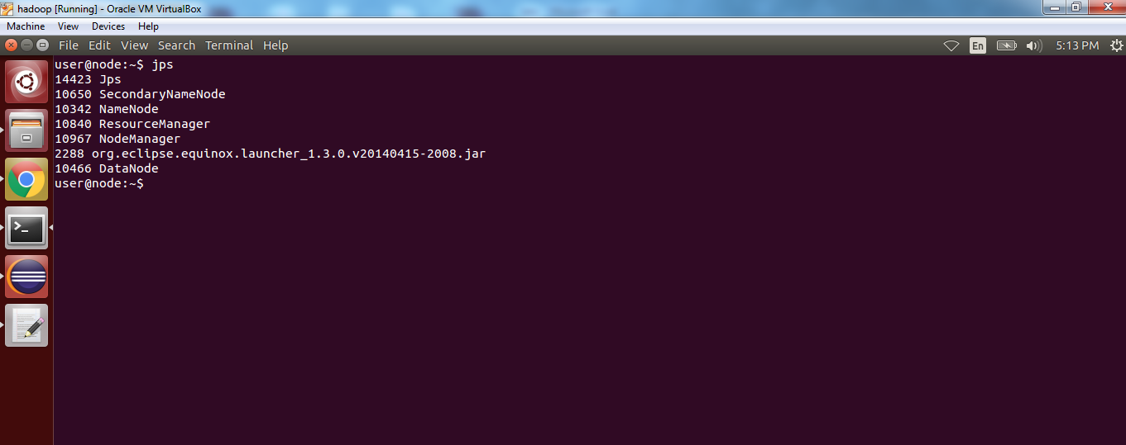
Implementation screenshot 1

Slide 32
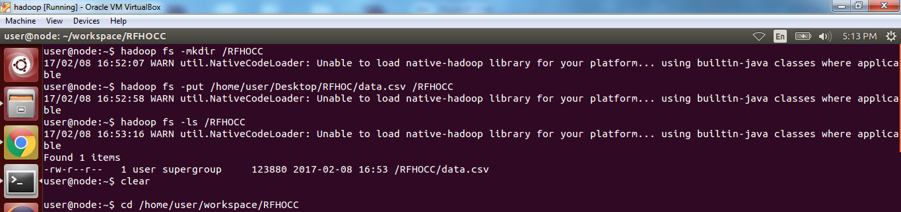
Screen shot 2

Slide 33
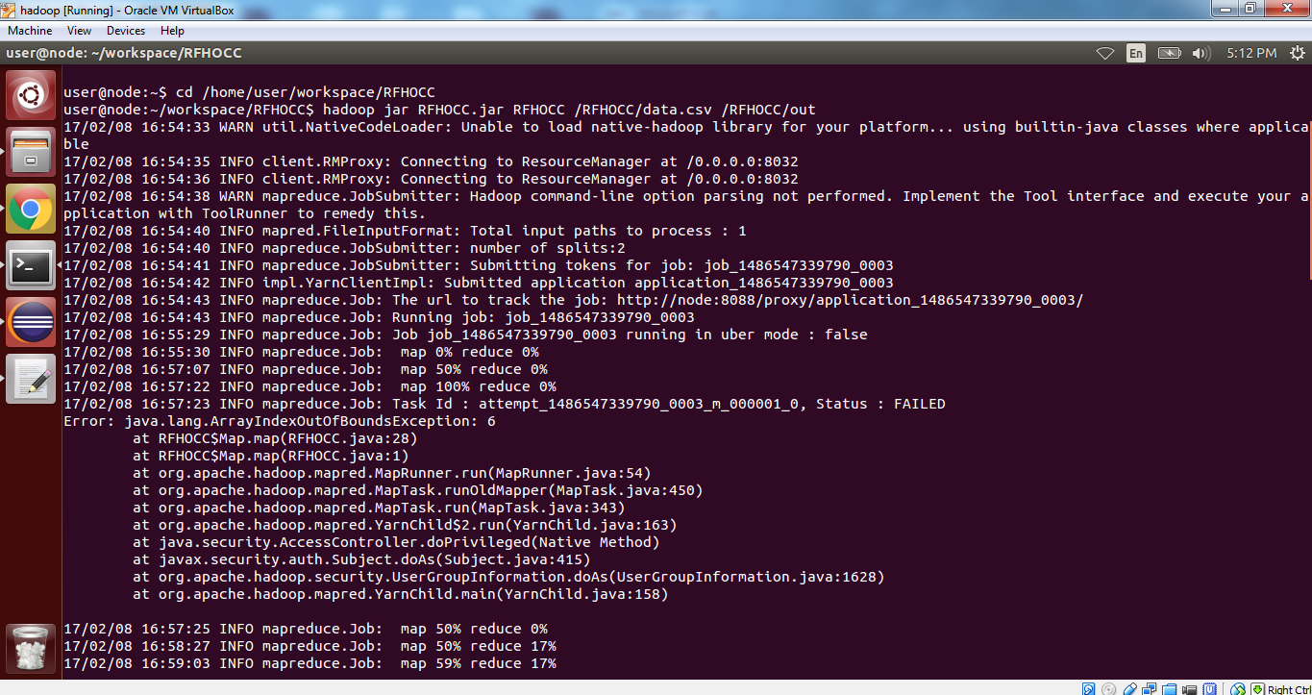
Screen shot 3
Map Reduce process starts

Slide 34
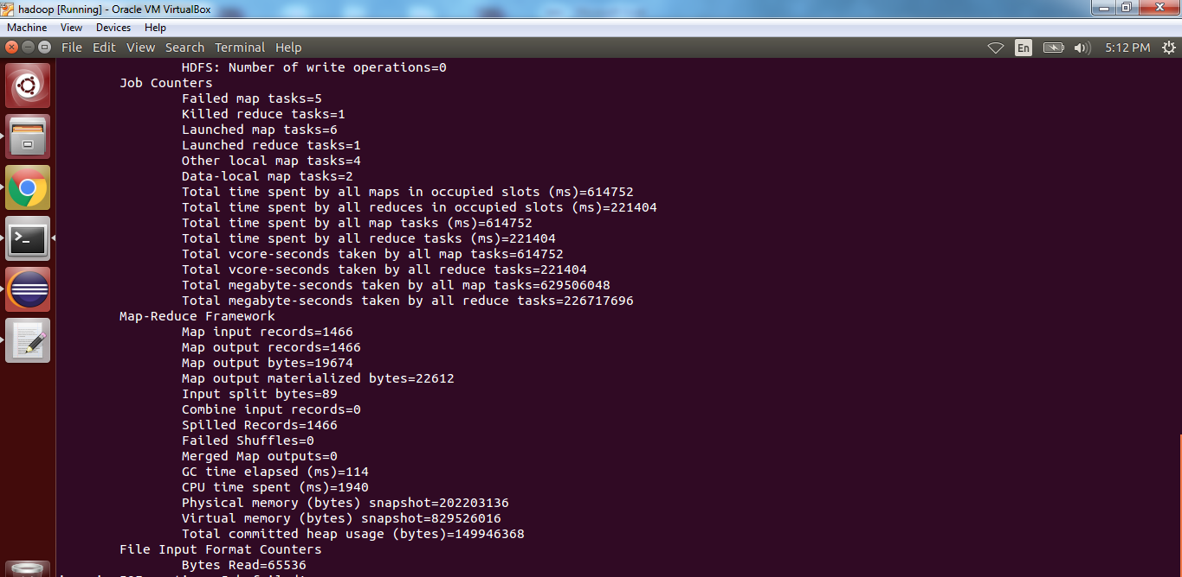
Screen shot 4

Slide 35
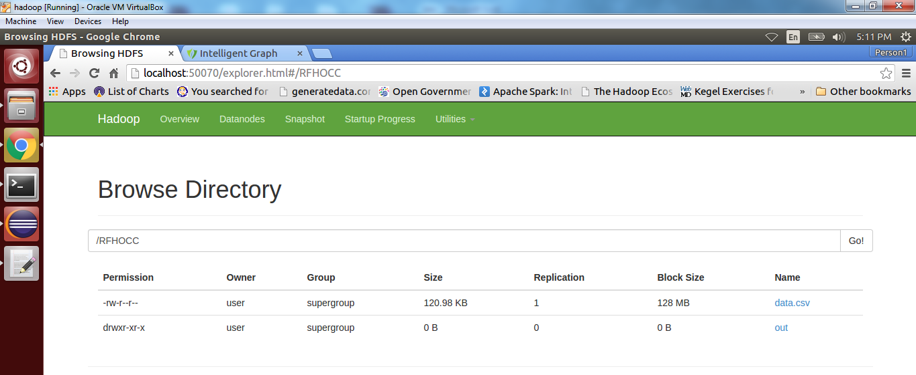
Screen shot 5

Slide 36
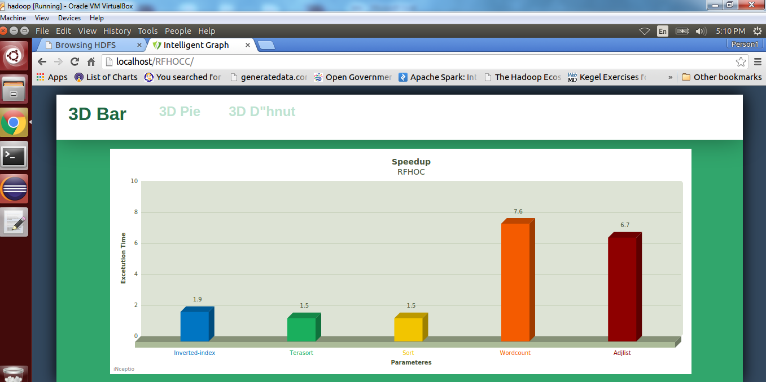
Screen shot 6

Slide 37
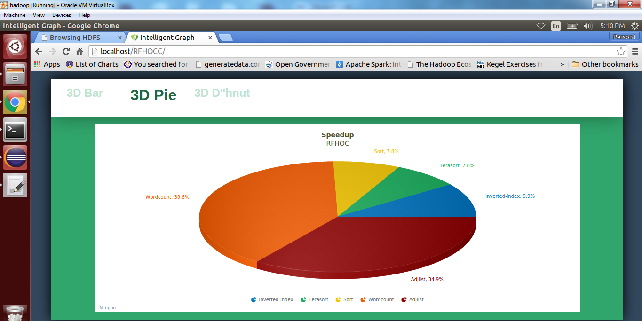
Screen shot 7

Slide 38
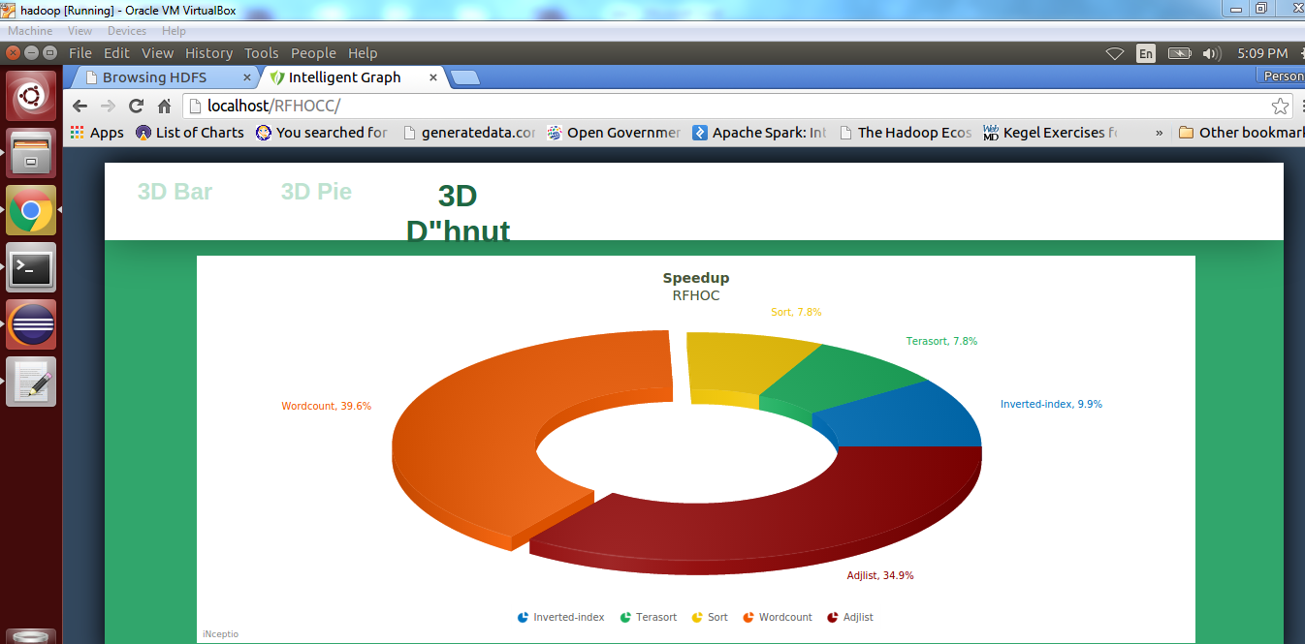
Screen shot 8

Slide 39
conclusion
In this project, we propose RFHOC, a novel methodology to optimize Hadoop performance by leveraging the notion of a random forest to build accurate and robust performance prediction models for the phases of the map and reduce stage of a Hadoop program of interest. Taking the output of these models as the input to a genetic algorithm to automatically search the Hadoop configuration space yields a Hadoop configuration setting that leads to optimized application performance. We has taken five input data sets ranging from 50 GB to 1 TB.
The results show that RFHOC speeds up Hadoop programs significantly over the previously proposed cost-based optimization approach. The speedups achieved are significant by 2.11_ on average and up to 7.4_. Furthermore, we find RFHOC’s performance benefits to increase with increasing input data set sizes.

Slide 40
Future enhancement
Random forest approach for auto tuning Hadoop configuration scheme is to give the best configuration .In future we can represent a enhanced parallel detrended fluctuation analysis. Algorithm (EPDFA) for scalable analytics on massive datasets EPDFA is a enhanced Hadoop platform whose parameters are applied by gene expression programming.

Slide 41


